Slide 1

Web development & Web designing
Introduction to HTML / CSS / Javascript

Slide 2
Introduction to Web development
HTML CSS JavaScript. How websites Works?
Basic Requirements to built a website.
What is a Web Browser?

Slide 3
WHAT IS A Web browser?
The purpose of a web browser (Chrome, Edge, Firefox, Safari) is to read HTML documents and display them correctly.
A browser does not display the HTML tags, but uses them to determine how to display the document.

Slide 4
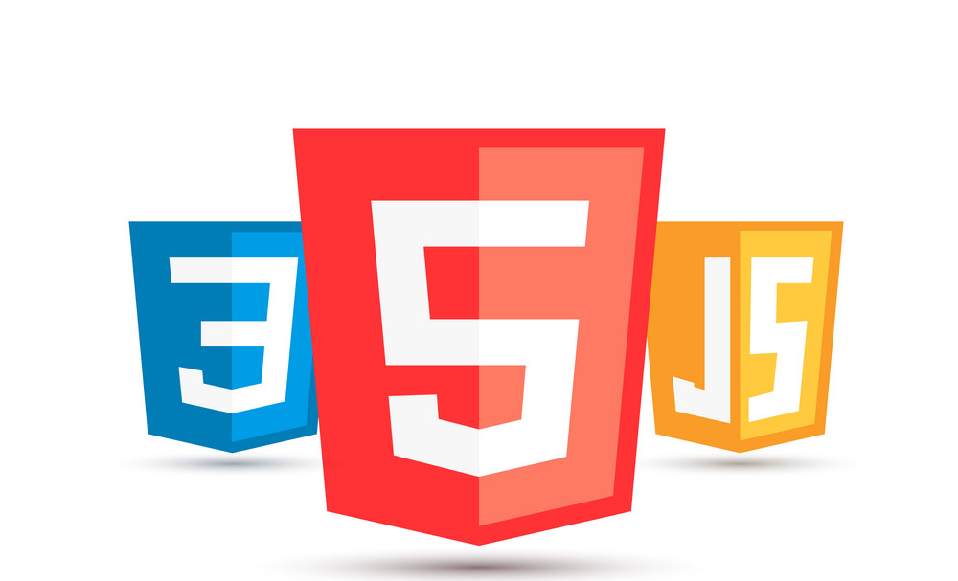
HTML
CSS
JavaScript

Slide 5

HTML stands for Hyper Text Markup Language.
HTML is the main Body or Structure of a Website.
HTML is the standard markup language for creating Web pages
HTML describes the structure of a Web page
The extension of HTML file is .html
HTML elements tell the browser how to display the content
HTML is mainly used to make Static Web pages.

Slide 6
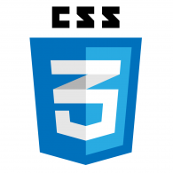
CSS stands for ( Cascading Style Sheet ).
CSS is a language for specifying how documents are presented to users, how they are styled, laid out, etc.
CSS is a rule-based language. It is used to define rules specifying groups of styles that should be applied to particular elements or groups of elements on your web page.
It makes our websites beautiful and modern looking.
The extension of a CSS file is .css.

Slide 7

JavaScript is the Programming Language for the Web.
JavaScript helps the web page to take decision. It plays the role of a brain in the Web page.
It allows client-side scripting to create completely dynamic web applications and websites.
JavaScript can update and change both HTML and CSS.
JavaScript can calculate, manipulate and validate data.
The extension of a JavaScript file is .js

Slide 8
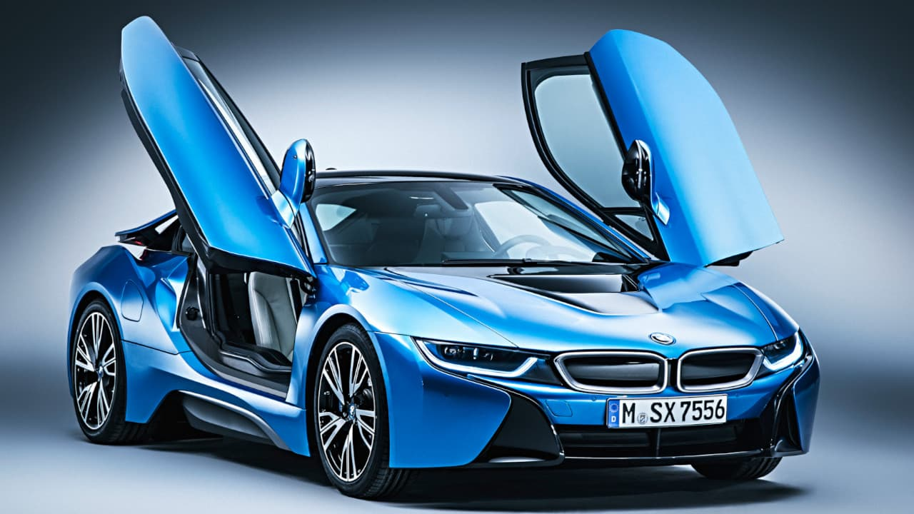
Let us understand with an example

Slide 9
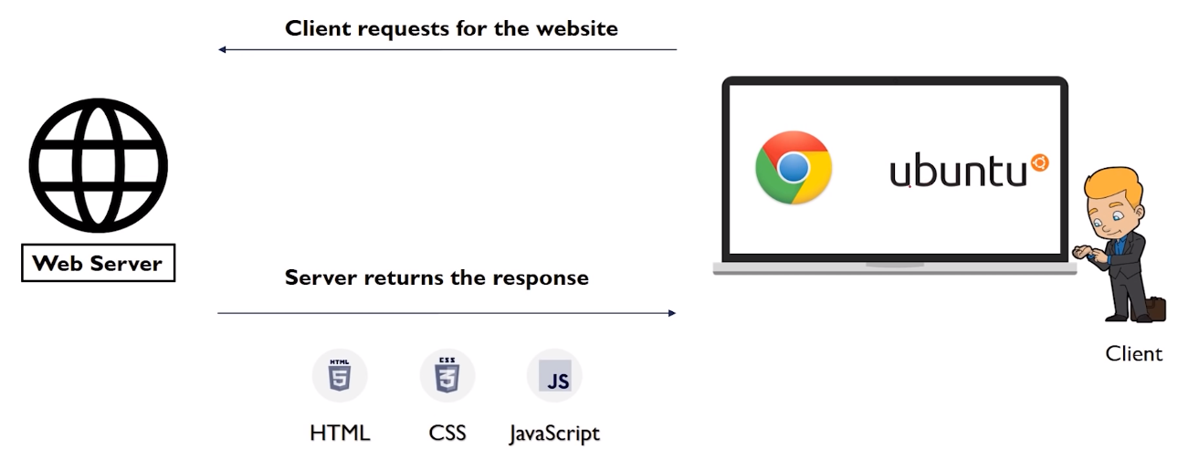
How websites works?
www.facebook.com
Web browser
192.168.10.1

Slide 10
Static And Dynamic Websites
Static Websites
Dynamic Websites
Static Websites are those, whose content and images do not change through out the process.
It doesn't have any Database to store any kind of information of the user.
It is faster than Dynamic sites.
Static Websites always dependent on the Developer.
HTML, CSS, Bootstrap.
Dynamic Websites offer unique content / images to visitors each time they load the site.
Dynamic Websites must connected to the Database to update or store information.
It doesn’t always dependent on the Developer.
Dynamic websites takes some time to load the web page.
Php, MySQL,WordPress, JavaScript.

Slide 11
Dynamic Websites Frontend + Backend
Dynamic Websites always contains two phases, one is for the User and the other one is for Admin.
The user is only able to view and insert the data, but he is not able to update the data.
Admin is only able to update and change the data through control panel of the website.

Slide 12

How to start with Web?
Visual Studio Code is a free IDE (Integrated Development Environment).
It helps the user to make wok easily.
It gives suggestions to the user ,and makes the work flow easy.
It helps the user to code easily on multiple tabs.
It is a free open source IDE from Micro Soft.

Slide 13
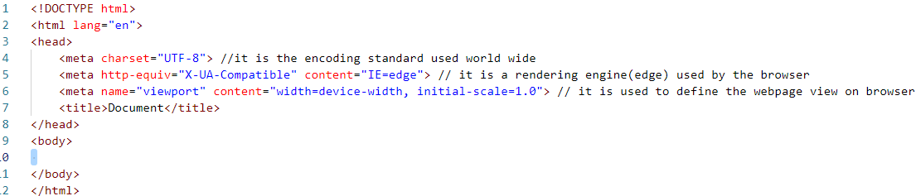
Starter Template
It is used for SEO

Slide 14
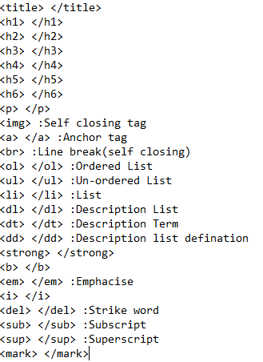
Tags in HTML

Slide 15
List in HTML
Ordered List
Un-ordered List
Description List

Slide 16
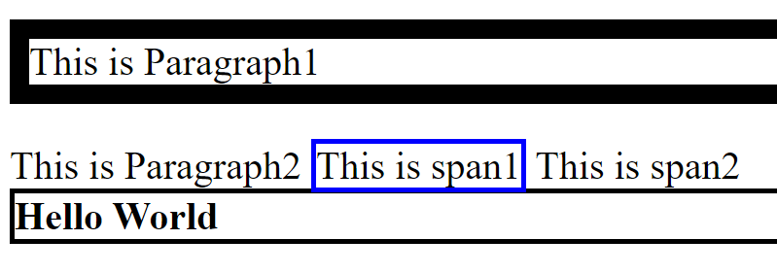
Inline elements and block elements

Slide 17
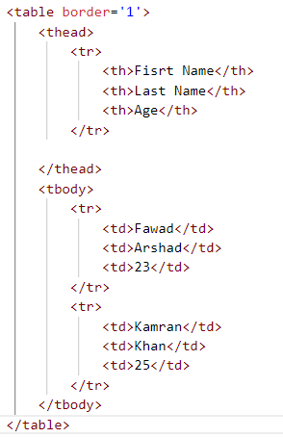
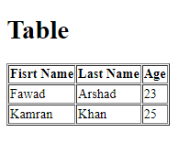
Tables in HTML

Slide 18
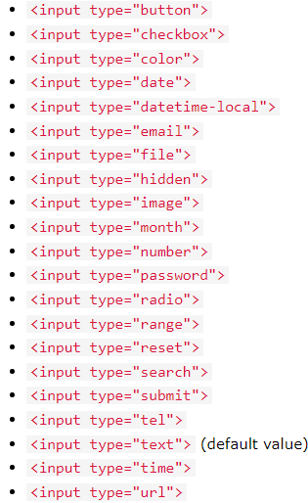
Input Tags in HTMl
The <input> tag specifies an input field where the user can enter data.
The <input> element is the most important form element.
The <input> element can be displayed in several ways, depending on the type attribute.
The different input types are as follows:

Slide 19

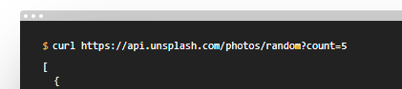
Hyperlinks And Anchor tags
Hyperlinks are text and images in a web page that links us to another web page.
Usually blue and underlined.
Mouse pointer changes to small hand.
Anchor tag is used to link hyperlinks.
< a > href=“ // ” < /a > (href=hyperlink reference)

Slide 20
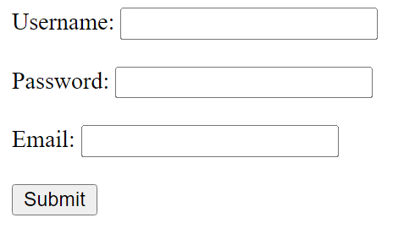
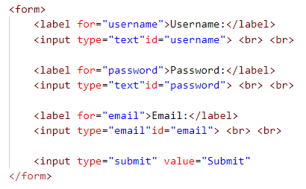
Forms In html

Slide 21
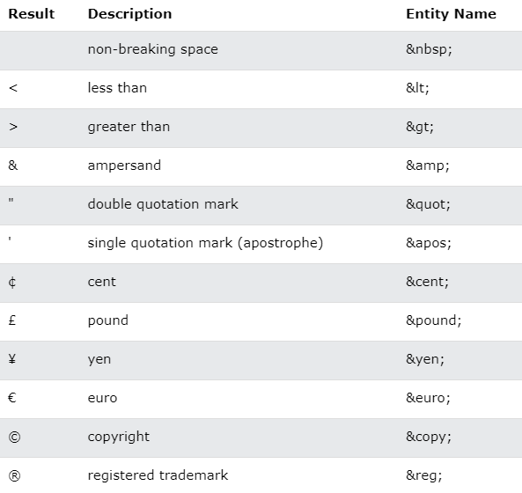
HTML Entities

Slide 22
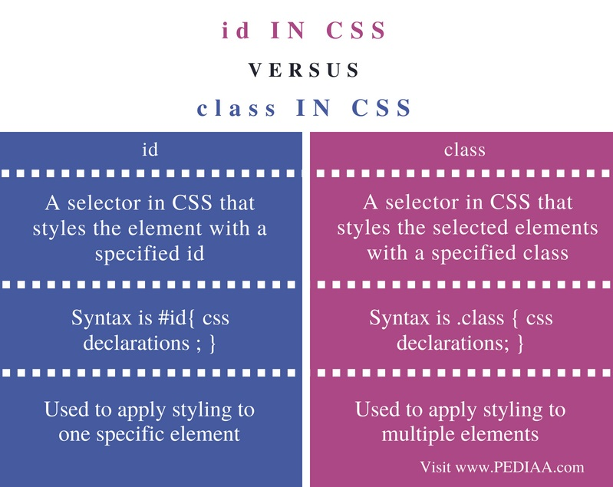
Id and class

Slide 23
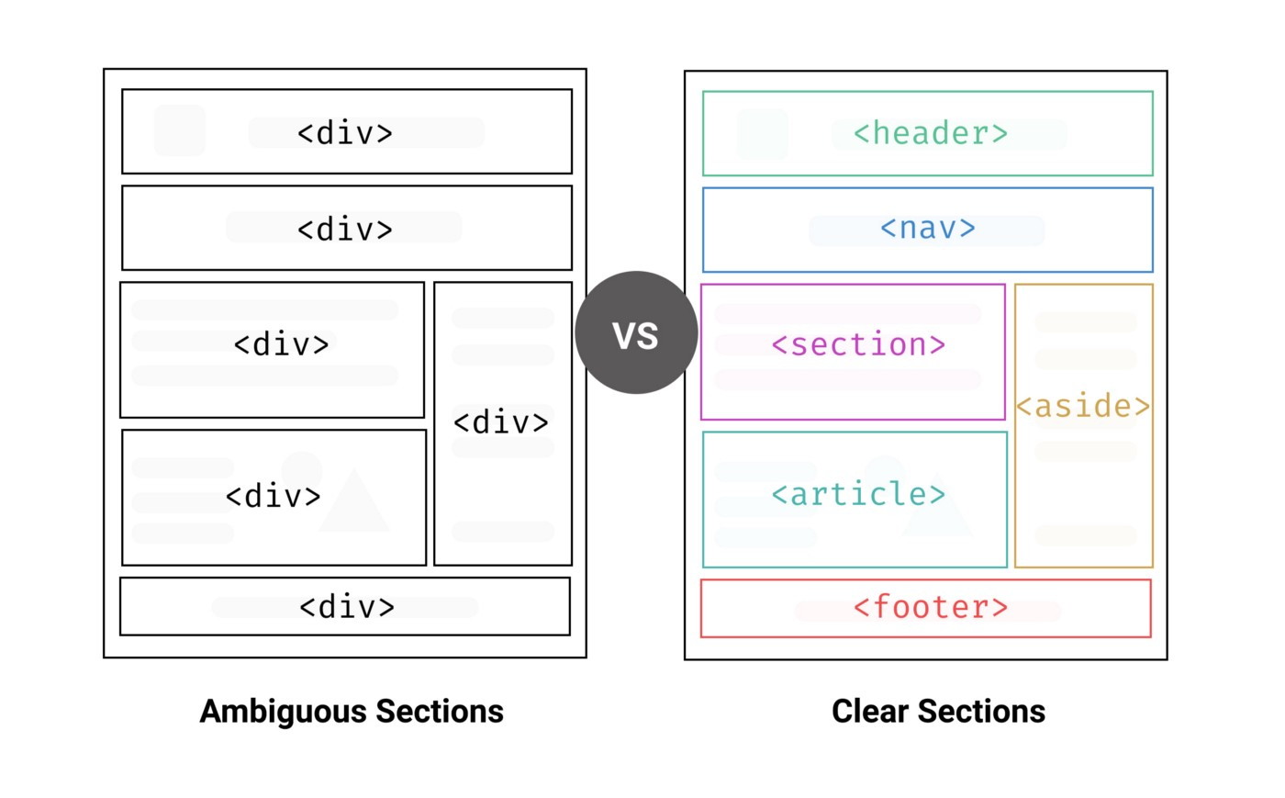
Semantic tags

Slide 24
Selectors in css
.
#
*
P
h1

Slide 25
Specificity in css
Classes are more specific than normal HTML Element.
IDs are more specific than class Element
Inline style attribute are more specific than IDs
Inline style attribute > ID selectors > Class selectors > Element selector.
Calculating specificity:
( 0 , 0 , 0 ,0 )

Slide 26
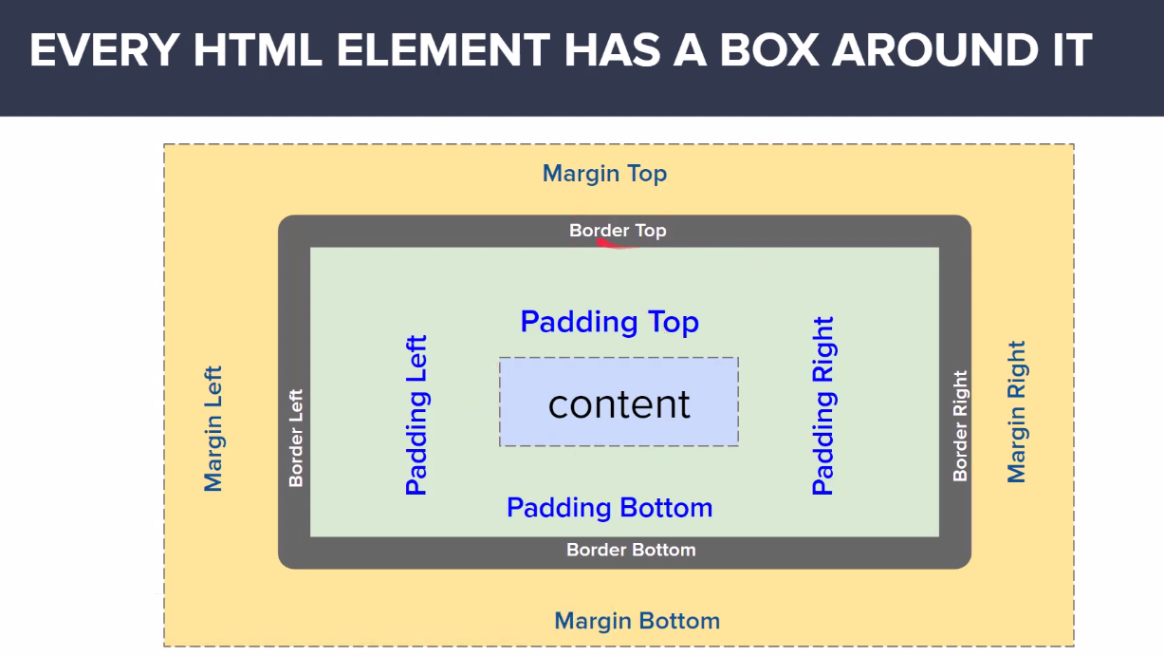
BOX Model

Slide 27
Css reset
*{
Margin: 0px;
Padding: 0px;
box-sizing= border-box;
}

Slide 28
Css units
Absolute Units.
pixels
Inch
Centimeter
Point
Relative Units.
Percentage
Relative element
Element

Slide 29
Block elements anD inline elements
Block Elements
Inline Elements
Heading(1-6)
P, div , ul , li
Form , article , aside , main
Nav , header
Span
Image
Text area
A

Slide 30
Inline elements
Margin top and bottom didn’t apply on inline text elements.
Width and height didn’t change in inline elements.
Padding top and bottom will mess-up the flow and it over flows the border.
Exceptional case of inline image element.
We can apply height or width to image element.

Slide 31
Inline-block element
Inline-block elements are formatted same as inline element, where it doesn’t start on a new line. But you can set width and height of the element.

Slide 32
Pseudo elements ::
Content property is mandatory in pseudo element.
We can not use pseudo element with image.
Pseudo element is itself an element.
Pseudo element is formatted as inline element.
First letter, first word.
Selection
Before
After

Slide 33
Floats in Css
Float none
Float left
Float right
Float clear

Slide 34
Css positions
Static
Relative
Absolute
Transform – translate(x-axis , y-axis)
Z-index
Fixed (It doesn't stay in the normal flow of the document)
Sticky (It stays in normal flow of the document)

Slide 35
Different Icons in html
https://fontawesome.com/icons/instagram?s=brands
https://cdnjs.com/

Slide 36
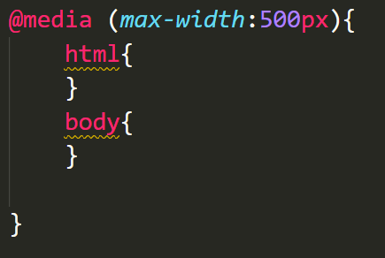
Media queries
Breakpoint

Slide 37
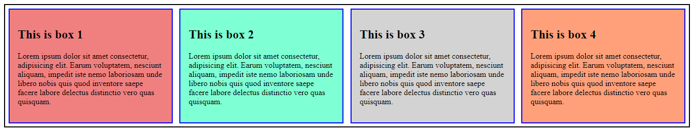
flexbox
Flex-container.
Flex-items.
Flex Items

Slide 38
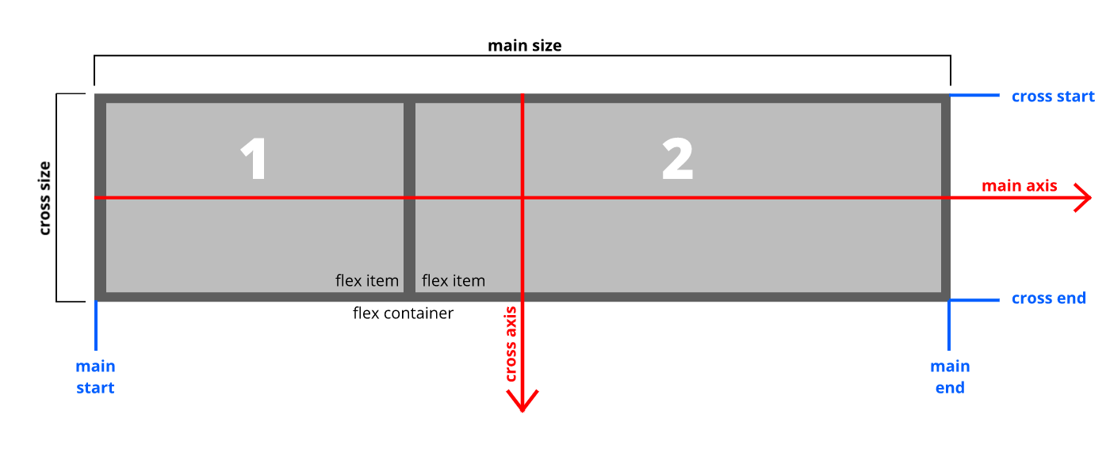
Flexbox terminologies

Slide 39
Flex axes (flex direction)
Row (main axis: Left to right).
Row-reverse (main axis: Right to left).
Column (main axis: Top to bottom).
Column-reverse (main axis: Bottom to top).

Slide 40
Flex container properties
Display flex
Flex-direction (row , row-reverse , column , column-reverse)
Flex-wrap (no-wrap , wrap , wrap-reverse)
Justify-content ( it depends on main-axis ) flex-start, flex-end, center, space-between, space-around, space-evenly.
Align-item ( it depends on cross-axis ): stretch, flex-start, flex-end, center
Align-content ( it depends on cross-axis , for more than 1 row ): flex-start, flex-end, space-between, space-around, center
Flex-flow ( flex-direction + flex-wrap): ((row, row-reverse, column, column-reverse), (wrap, no-wrap, wrap-reverse))

Slide 41
Flex item properties
Align-self ( It overwrites the align-items property)
Order ( It defines the position of boxes; integer value with no unit)
Flex-basis ( It depends on main-axis):row/width, column/height
Flex-grow ( Empty space utilization; integer value with no unit)
Flex-shrink (items width utilization in px)
Flex (short key: flex-grow, flex-shrink, flex-basis)
eg:( 2 , 1 , 200px )

Slide 42
Animation in Css
Animation name
Animation duration
Animation delay
Animation iteration count
Animation fill-mode
Animation timing function
Animation: (name duration fill-mode delay timing-function)

Slide 43
Css transitions (Change of state)
Transition name
Transition duration
Transition delay
Transition-timing function (ease-in, ease-out, ease-in-out)
Transition: transform

Slide 44
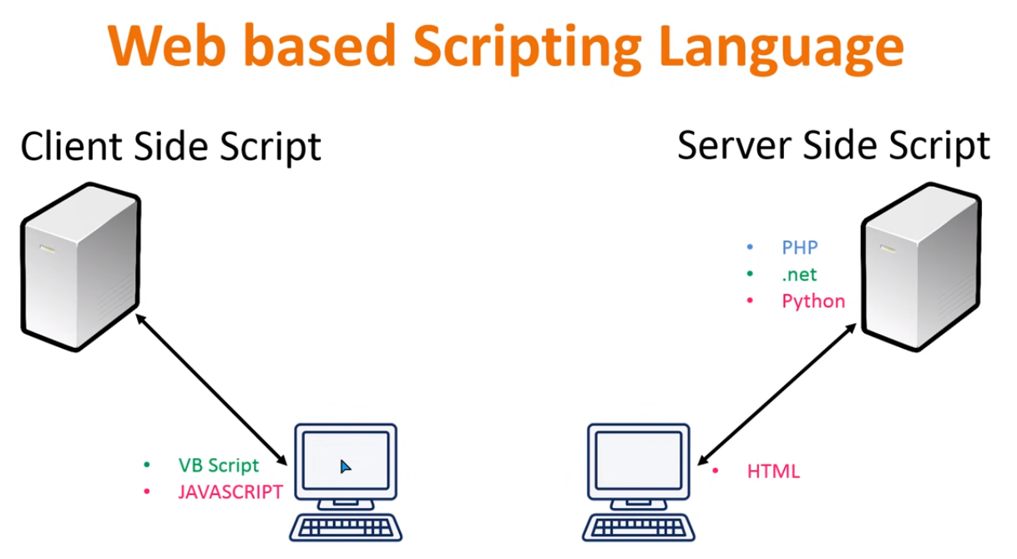
Javascript (javascript is a client side scripting language)

Slide 45
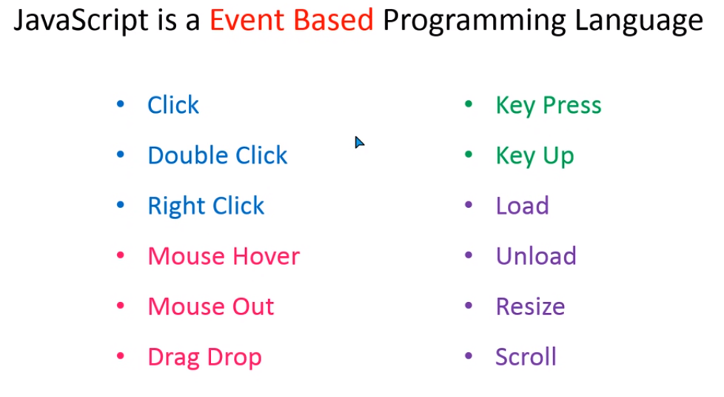
What is jAVAsCRIPT

Slide 46
Benefits of learning Js
Web Development
Desktop App Development
Mobile App Development

Slide 47
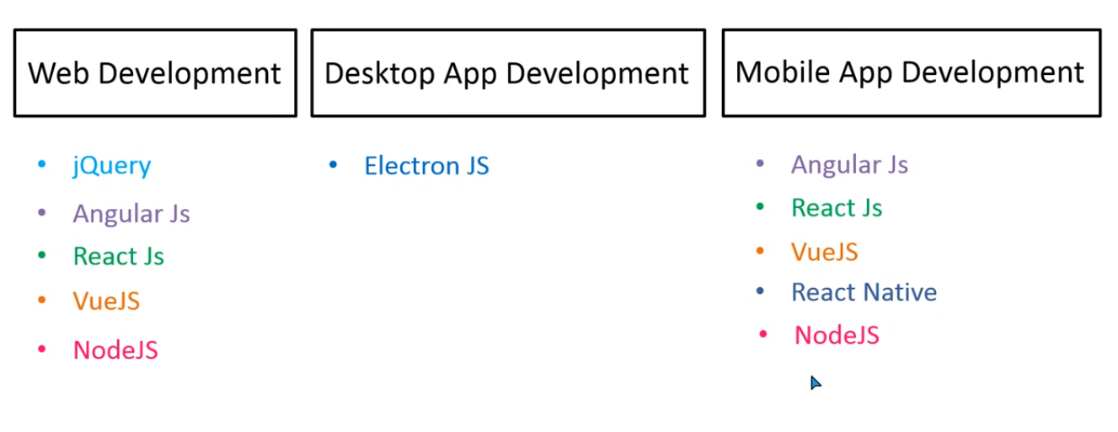

Slide 48
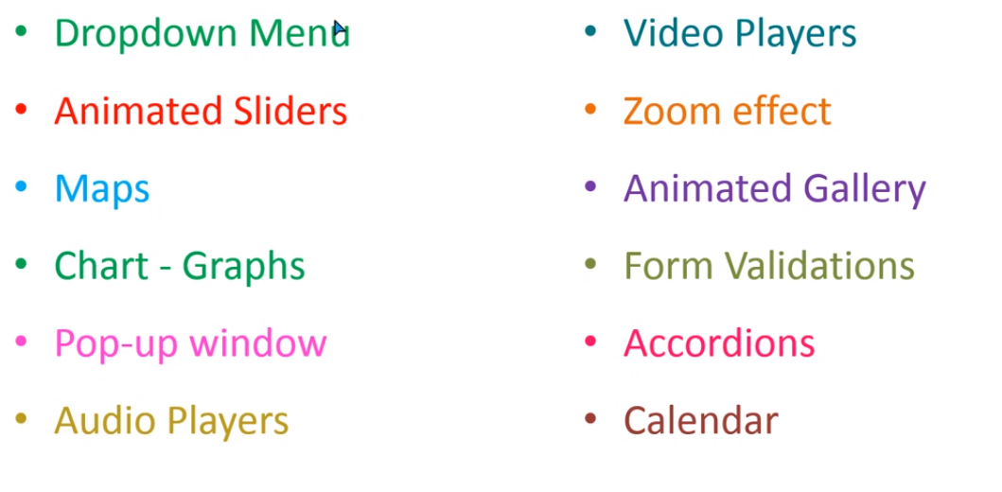
JAvascript in web development

Slide 49
How to implement Js in web development
In-page JavaScript
External JavaScript.

Slide 50
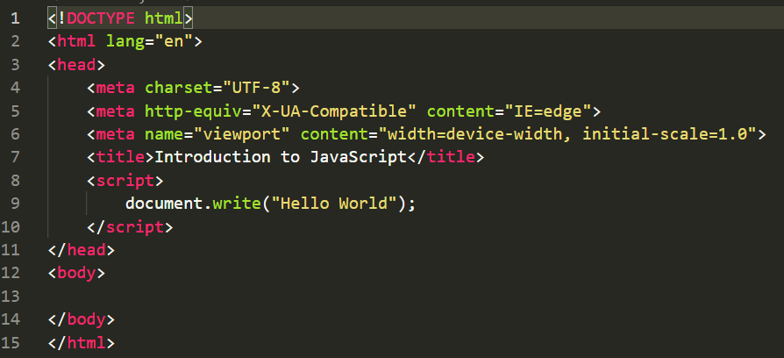
Internal JavaScript

Slide 51
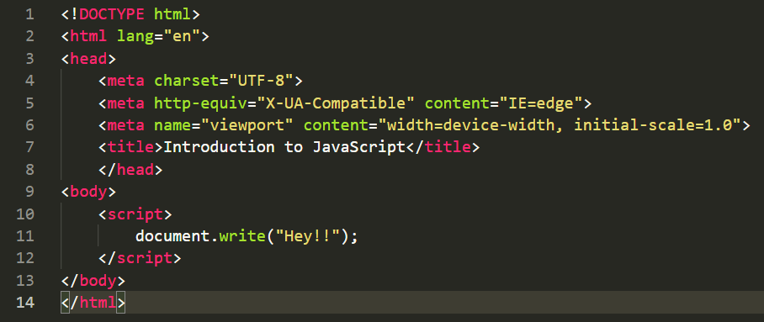
Internal JavaScript

Slide 52
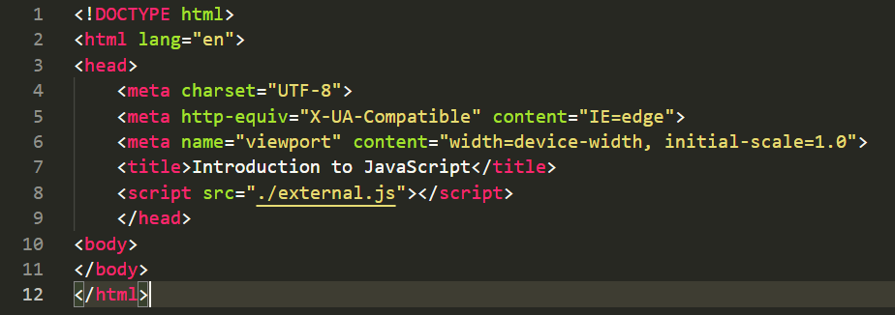
External JavaScript

Slide 53
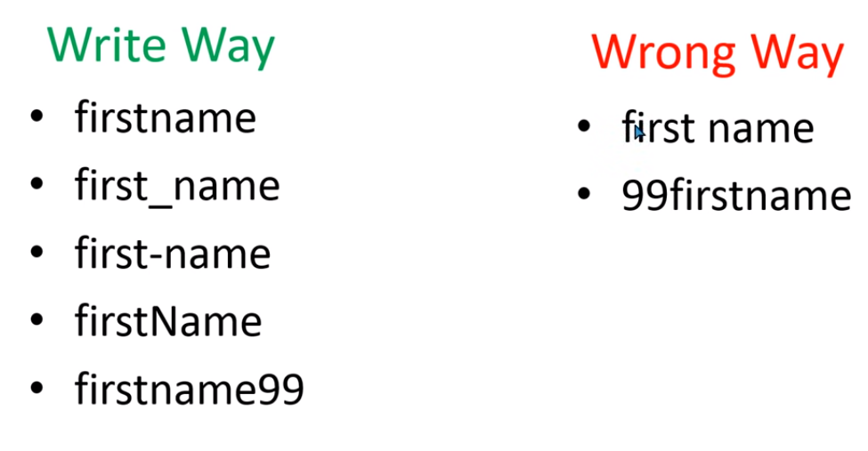
Variable declaration

Slide 54
Types of variables
Var
Let
Const

Slide 55
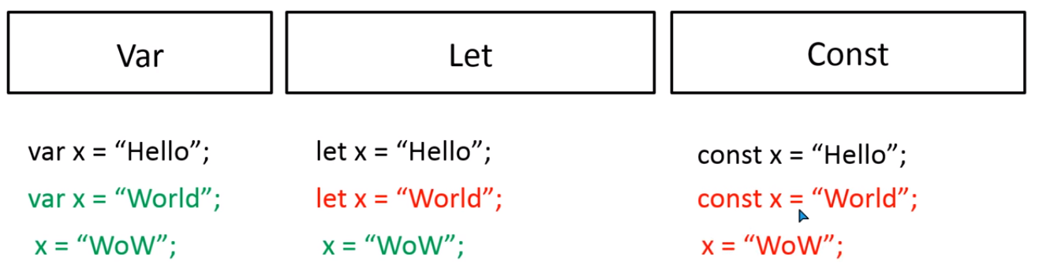

Slide 56
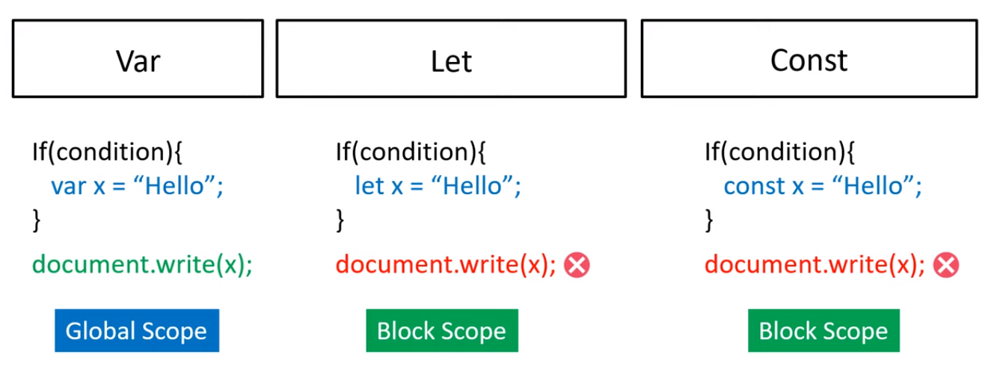
Scope of variables

Slide 57
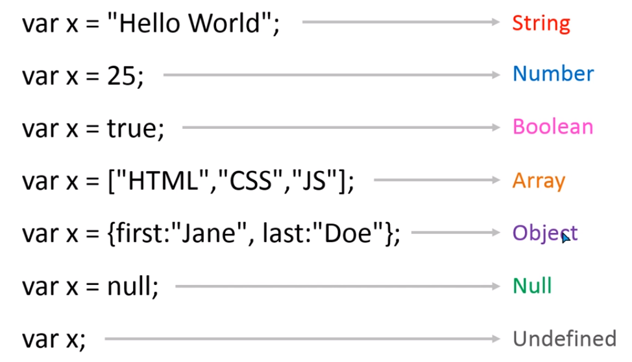
Data types in js

Slide 58
Strings presentation
“Hello World”. (Double inverted commas)
‘Hello World’. (single-inverted commas)
`Hello World`. (Backticks inverted commas)

Slide 59
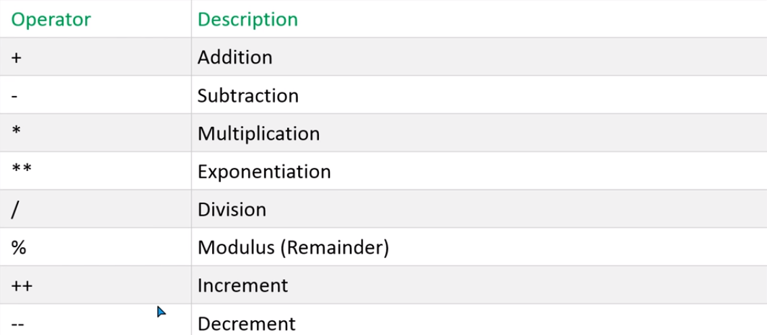
Arithmetic operators

Slide 60
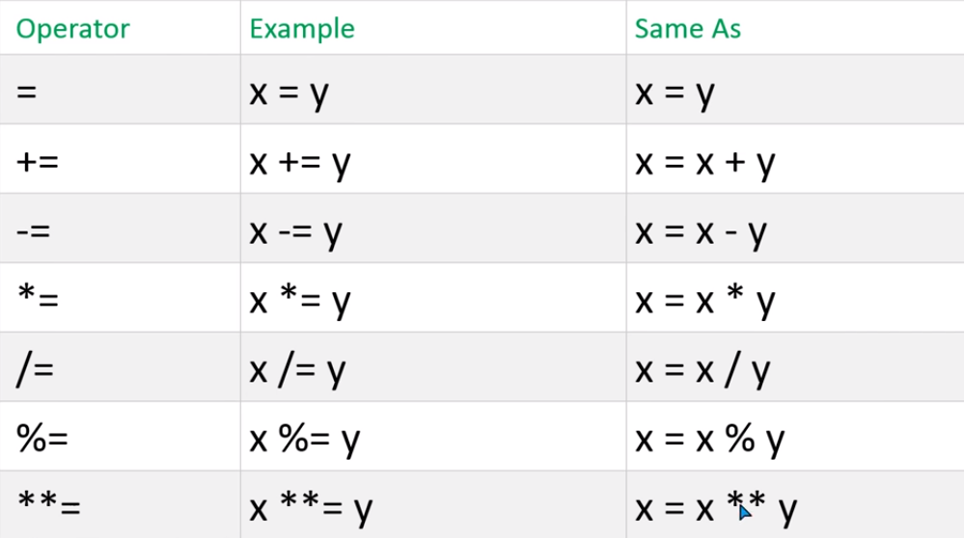
Assignment operators

Slide 61
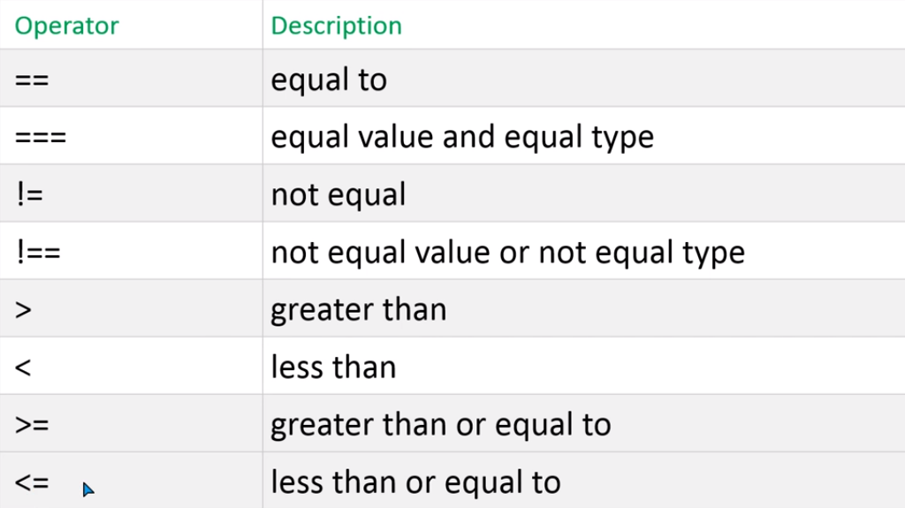
Comparison operators in js

Slide 62
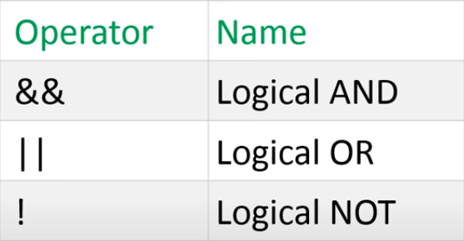
Logical operators

Slide 63
Types of Data Types in js
Primitive Data type
Reference Data type
Strings
Numbers
Boolean
Null
Undefined
Symbols
Arrays
Object literals
Functions
Dates

Slide 64
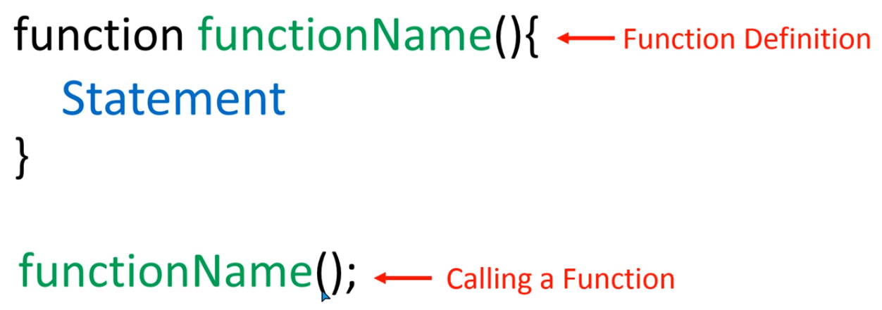
Functions in js

Slide 65
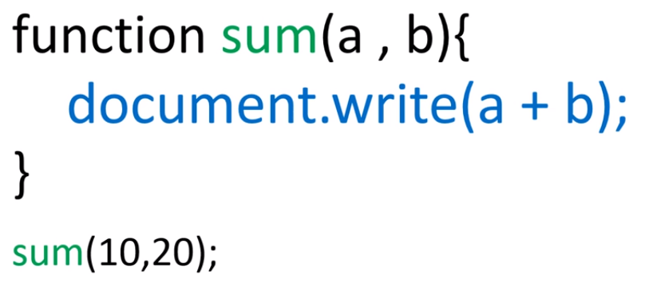
Functions with parameters

Slide 66
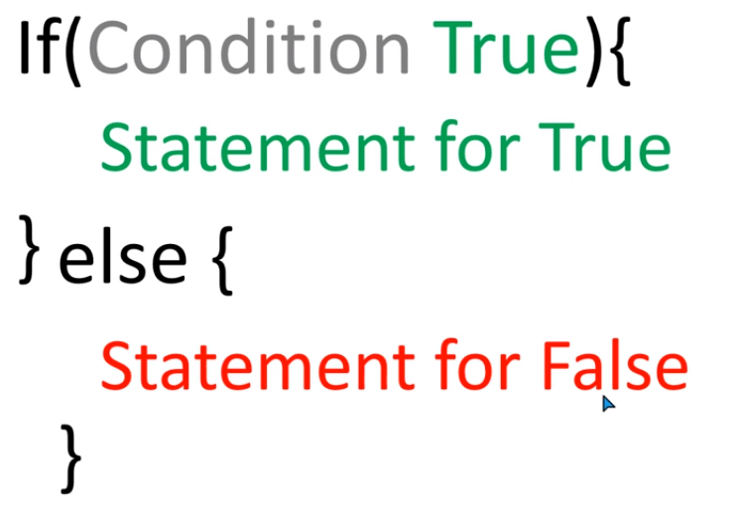
If - else condition

Slide 67
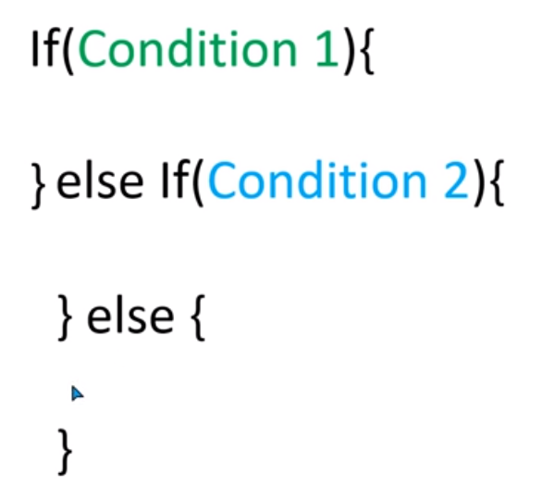
If else - if

Slide 68
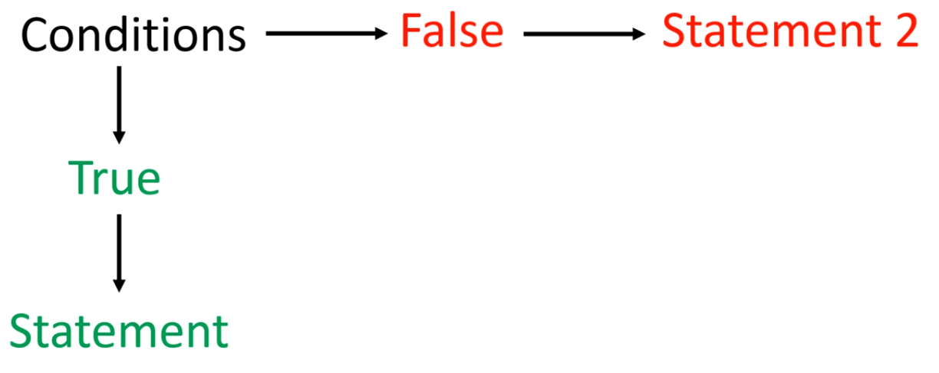
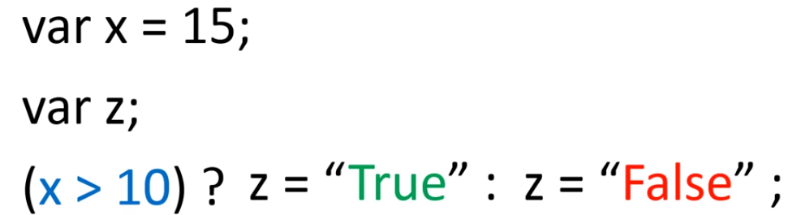
Ternary operator

Slide 69
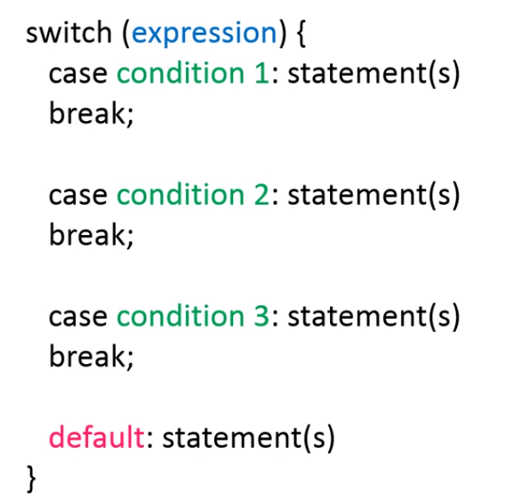
Switch - Case statement

Slide 70
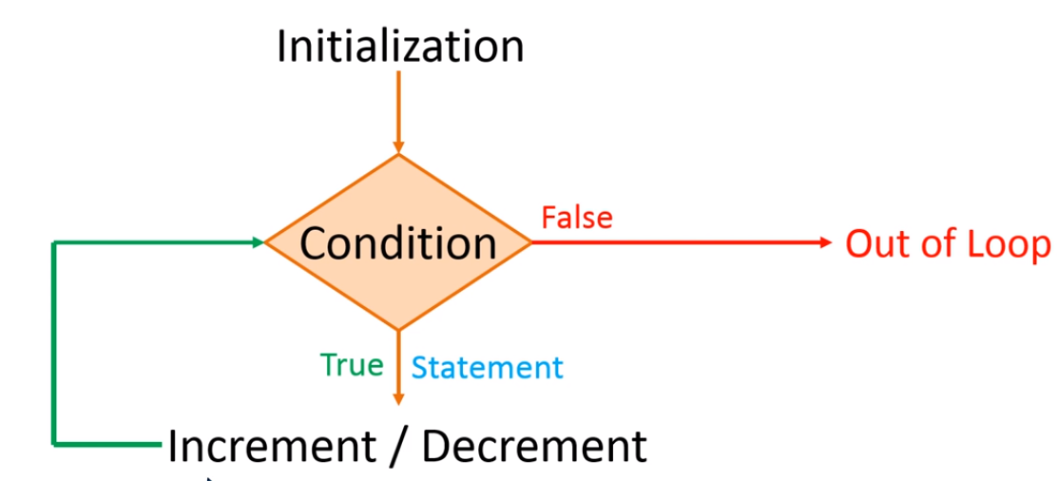
While Loops in js

Slide 71
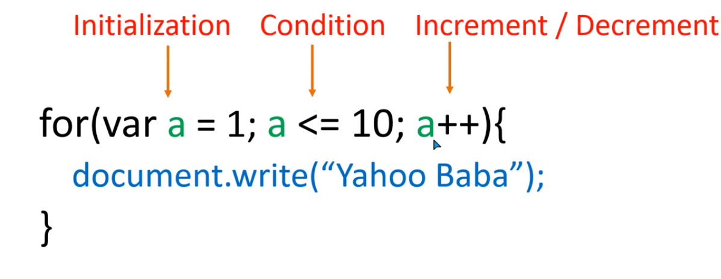
For loop in js

Slide 72
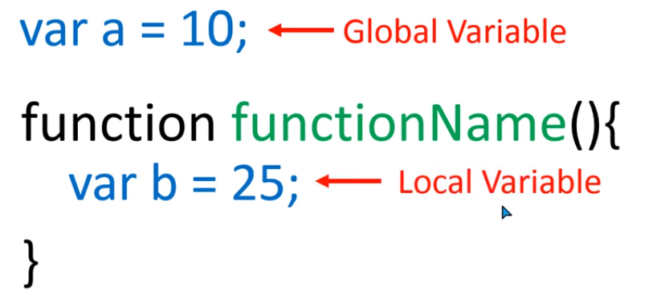
Global and local variables

Slide 73
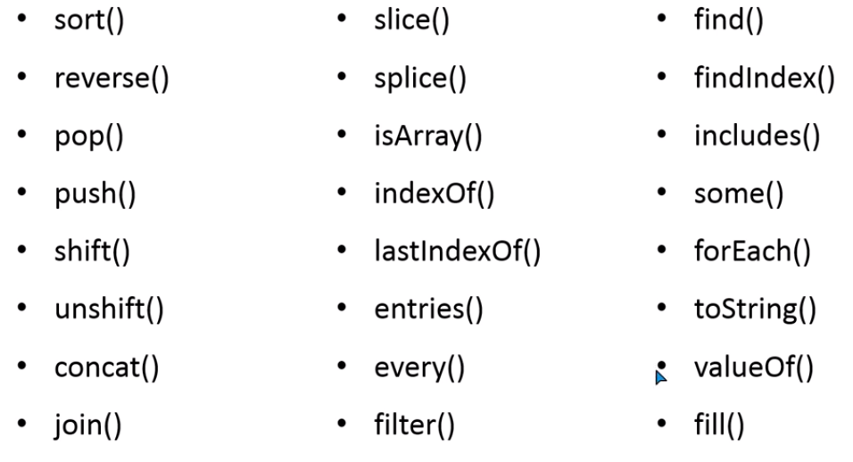
Array Methods in JS

Slide 74
Message box in js
Alert box
Confirm box
Prompt box

Slide 75
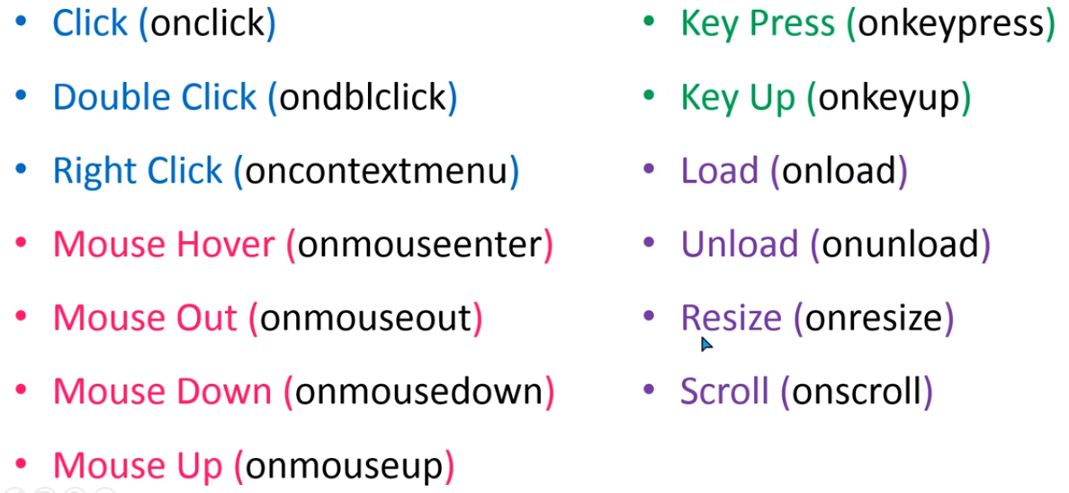
Events in JS
It only works with <body> or <form>

Slide 76
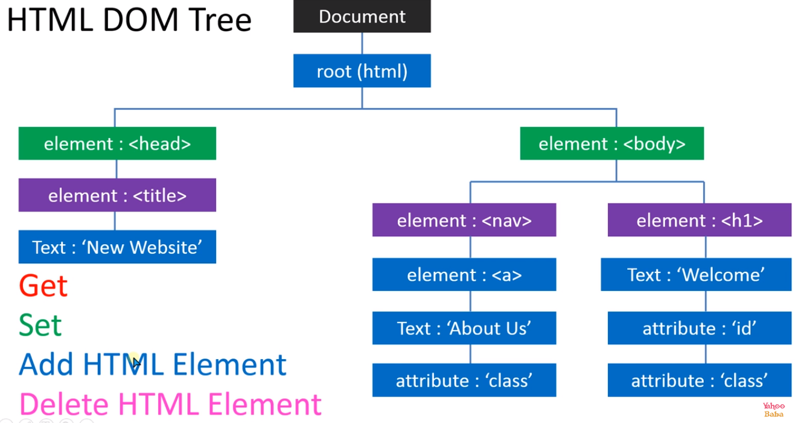

Slide 77
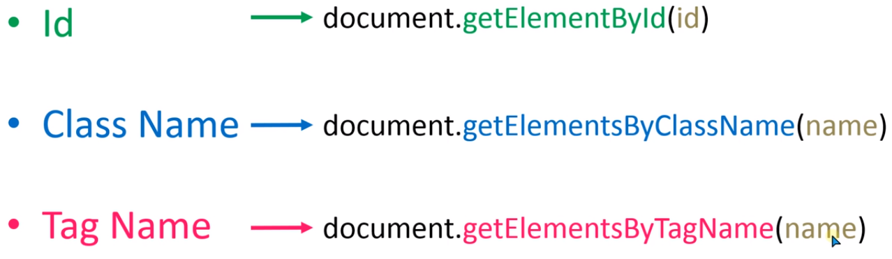
Dom targeting methods

Slide 78
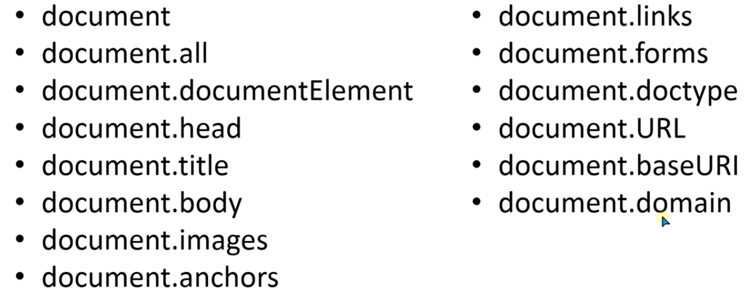
Dom targeting methods

Slide 79

Methods to Get Attribute value

Slide 80

Dom to set attribute value

Slide 81

Dom query selectors
Class, ID , Tag_Name

Slide 82
Regular expression
What is regular expression?
A regular expression is a sequence of characters that forms a search pattern.
Regular expression can be used to perform all types of text-search and text-replace operations.
Syntax: / Pattern / (Regular expression literal).
Functions in regular expression:
Exec( ). This function returns array for a match or null for no match
Test( ). This returns true for match and false for no match.
Match( ). This function returns array for a match or null for no match.
Search( ). This function returns index for a match or -1 for no match.
Replace( ).This will replace the first match string.

Slide 83

Regular Expression

Slide 84
Some REGEX
[A-Z], [a-z], [0-9], [A-Za-z], [A-Za-z0-9] From this to this
{10}, {3,10}, {5,} Range
(?=.*[0-9]) or (?=.*[A-Za-z]) At-least one-time

Slide 85

WHAT IS BOOTSTRAP

Slide 86

CSS FRAMEWORKS

Slide 87

Container class with different Break points

Slide 88

Container class width

Slide 89



Slide 90

Column classes

Slide 91
Some Main classes in bootstrap
Container
Container-fluid
Row (Grids)
Row-col-*
Col (col-1 to col-12)
Col-xl-1 to col-lg-12 , col-md-* , col-sm-*
Offset-1 to 11( offset-lg-* , offset-md-* , offset-sm-*)
Order-0 to 11( order-lg-* , order-md-* , order-sm-*)
M-auto(ms-auto , me-auto)

Slide 92


Slide 93

Padding classes

Slide 94

Background-color classes

Slide 95

Color classes

Slide 96
Justify content classes (horizontal alignment)
Justify-content-start
Justify-content-end
Justify-content-center
Justify-content-between
Justify-content-around
Justify-content-evenly

Slide 97
Alignment items classes (vertical alignment)
Alignment-items-start
Alignment-items-end
Alignment-items-center
Align-content ( it only works when height is given to the parent element )
( align-content-stretch , align-content-start/end , align-content-around , align-content-between )
Align-self-start
Align-self-end
Align-self-center

Slide 98

PAGINATION CLASSES

Slide 99

Pagination sizes

Slide 100

breadcrumb

Slide 101

Gutter padding classes

Slide 102

Border classes

Slide 103

Different types of borders

Slide 104
Shadow classes
.shadow
.shadow-sm.
.shadow-lg

Slide 105

Image classes in bootstrap

Slide 106

Image with text

Slide 107

Video classes

Slide 108

Card classes in bootstrap

Slide 109

Navigation bar

Slide 110


Indicators(Bars)

Slide 111

carousel

Slide 112

What is jquery?

Slide 113

Why use jquery?

Slide 114


Short selectors

Slide 115

CDN path

Slide 116

Ready Function

Slide 117

Implementation

Slide 118

On / off method

Slide 119

Hide and show method

Slide 120

Fade methods

Slide 121

Fade to

Slide 122

Slide methods

Slide 123

Animate method

Slide 124

J-query plug-ins (https://www.bestjquery.com/)

Slide 125

How to implement j-query plug-ins

Slide 126

UI/UX

Slide 127
UI/UX

Slide 128
UI/UX

Slide 129
Design Thinking Process and Its Phases
Design thinking is a methodology that attempts to solve complex problems in a creative and user-centric way. Core features of the design thinking methodology include:
Focus on end-users. The end-user plays a key role in the design thinking process—all key product design decisions are evaluated according to the end user’s needs and wants.
Solid problem framing. Rather than accepting the problem as given, designers explore the problem space to find a root cause of the problem. The insights they gain can help designers reinterpret the given problem.
Creating tangible solutions. Convey design solutions using sketching and prototyping as opposed to presentations and slide decks.

Slide 130
What is wireframe & Prototyping
A wireframe is a schematic or blueprint that is useful for helping you, your programmers and designers think and communicate about the structure of the software or website you're building.
Prototyping is a process in which design teams ideate, experiment with, and bring concepts to life, ranging from paper ideas to digital designs. At its core, a prototype is an early sample of a design that allows users to visualize or interact with it before a final product is developed.

Slide 131


Slide 132

Wire framing

Slide 133

Prototyping

Slide 134

Five phases of the design thinking process
The design thinking stages are:
Empathize. Understand the problem of the user for whom you are designing.
Define. Form a problem statement.
Ideate. Generate creative solutions to this problem.
Prototype. Build a tangible representation of this solution.
Test. Validate this solution with your target audience.

